Slide 1
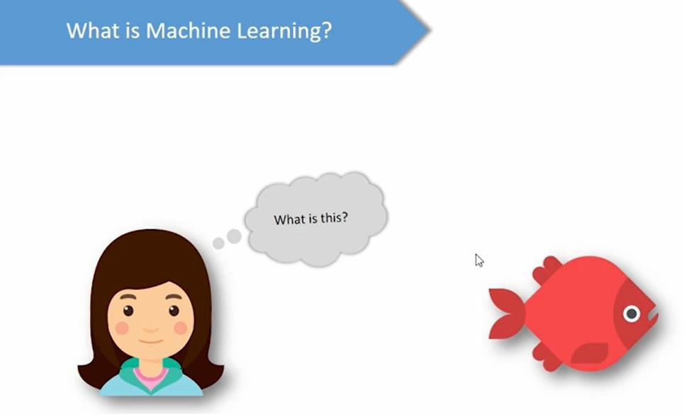
How a child learn this is a fish.

Slide 2

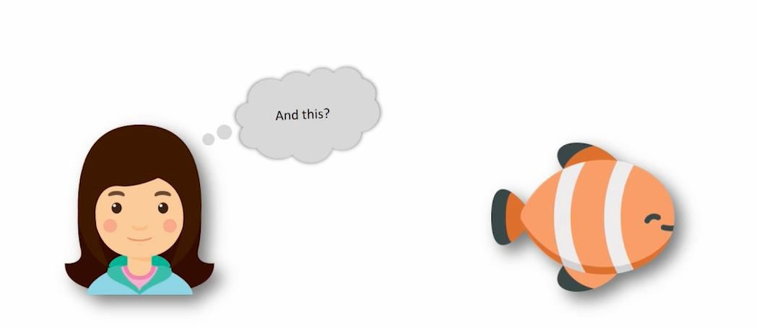

Slide 3
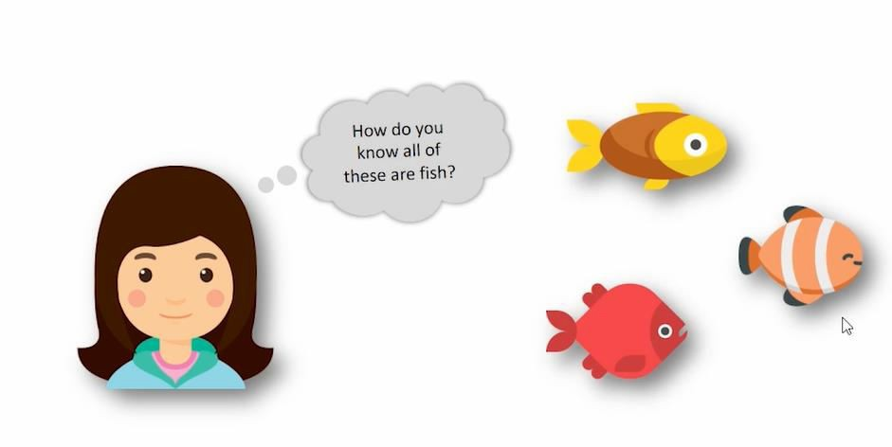

Slide 4

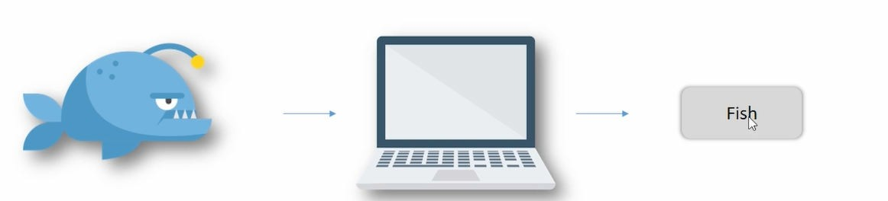
Learning/Train the machine
Machine Extract the features of fish (oval shape, tail) and identify the image is fish. Even if we give thousands of images machine will identify the fish image.
Training phase- We have to train the machine by giving more images. Machine learns the feature associated with the data.
Testing phase- If we are giving new image to the machine, machine will identify that is a fish. By giving new image, we have to test the machine how much is has learnt.

Slide 5
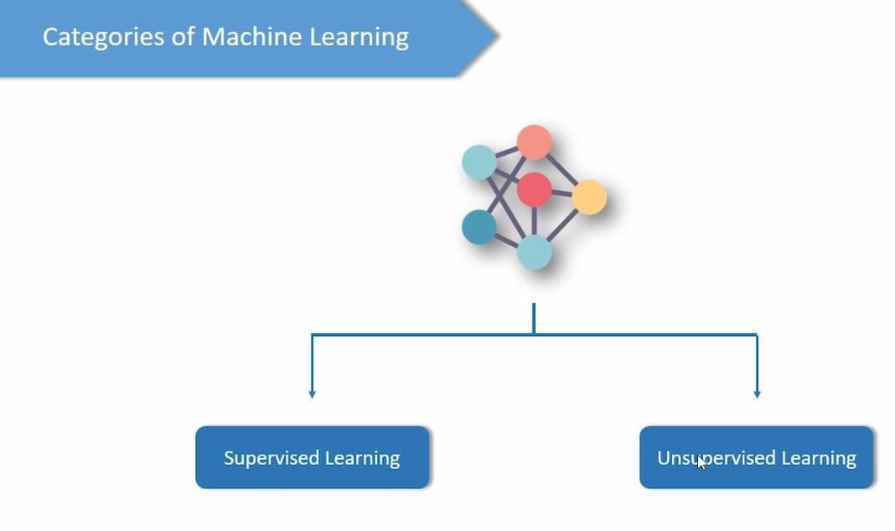
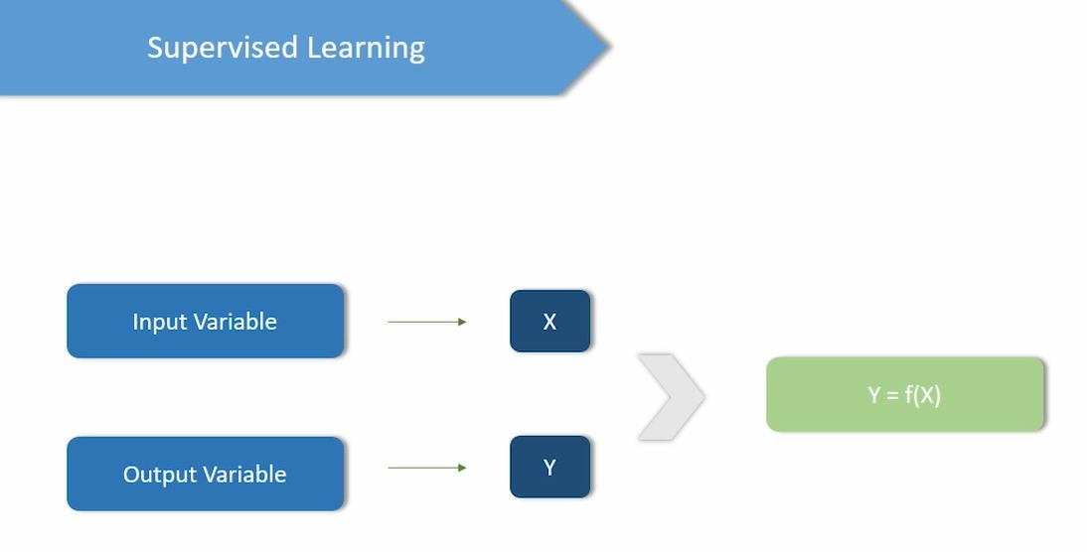
X-Independent variable Y-dependent variable

Slide 6
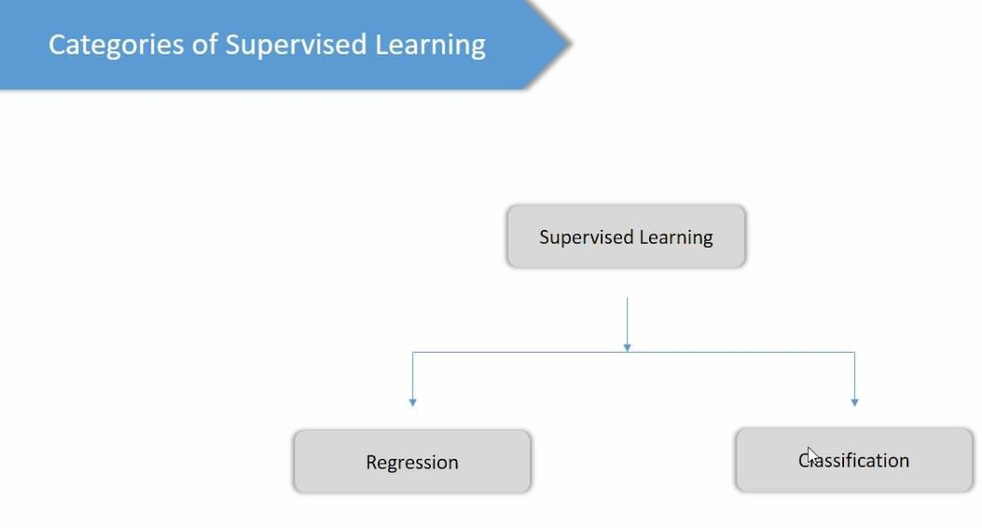
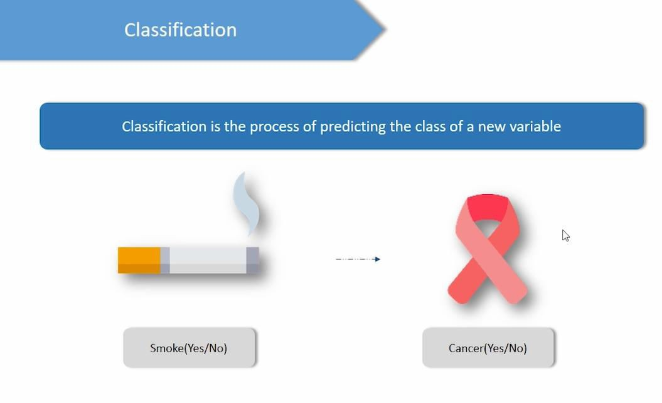
Cancer(Output) is classified based on the input variable(smoke).
Output vairaible may be binary classification(yes/no) -0 and 1 or multi class classification.(Categorical)

Slide 7
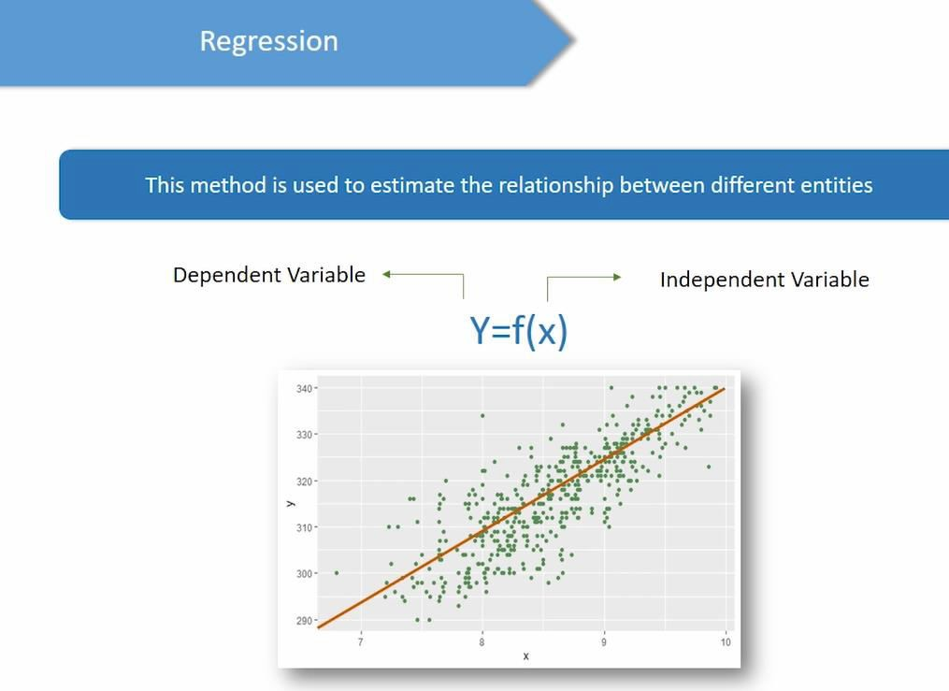
In linear regression, dependent variable Y is continuous numerical.
In classification output variable is categorical. Whereas in linear regression, dependent variable Y is continuous numerical.
Eg.X-cgpa
Y-GRE score

Slide 8
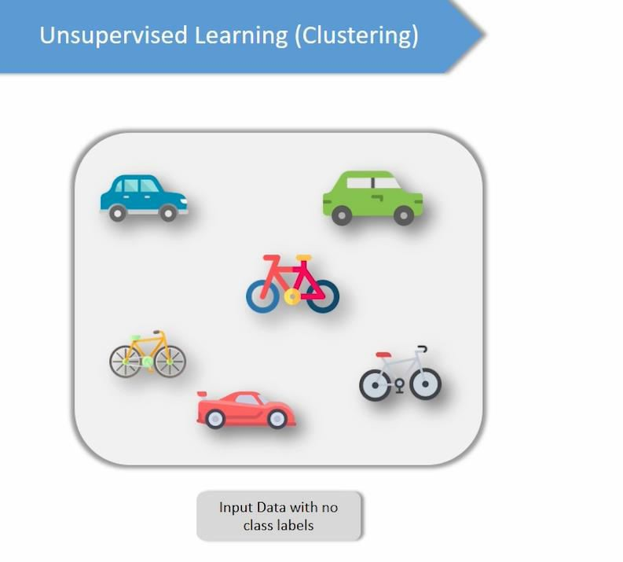
Unsupervised learning:
You will not have dependent variable and independent variable. Here you have data points without class label.
Here we have images of the car and bicycle without label.

Slide 9
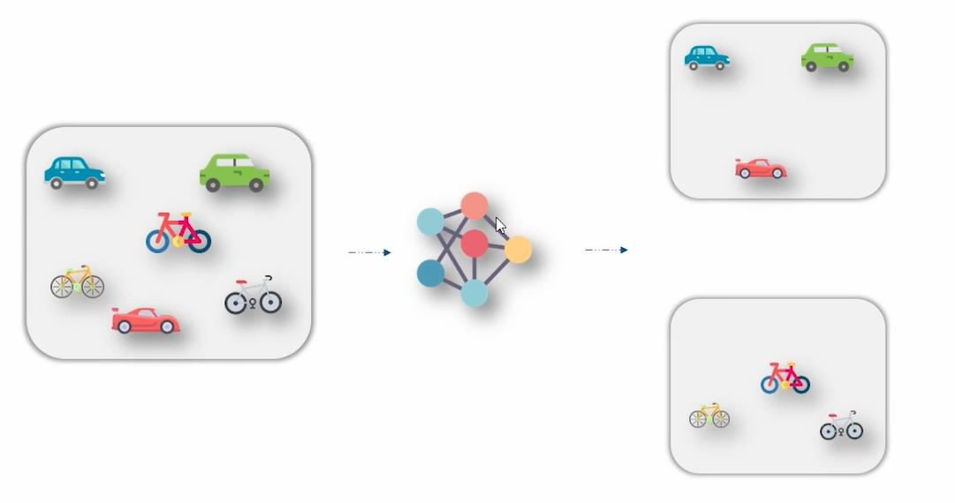
Cluster 1 – cars Cluster 2 – bicycle
Intra cluster similarity – cluster points within the cluster is similar
Inter cluster dissimilarity- cluster points between the clusters are dissimilar(cluster 1 and cluster 2)

